Slide 1



Physics-Informed Machine Learning Simulator for Wildfire Propagation
SIMONE
3:30
AAAI Spring Series 2021 Symposium, March 22
Luca Bottero¹, Francesco Calisto¹, Giovanni Graziano¹, Valerio Pagliarino¹, Martina Scauda², Sara Tiengo¹, Simone Azeglio³
¹ Student in Physics – University of Turin
² Student in Mathematics – University of Turin
³ Student in Physics of Complex Systems – University of Turin

Slide 2
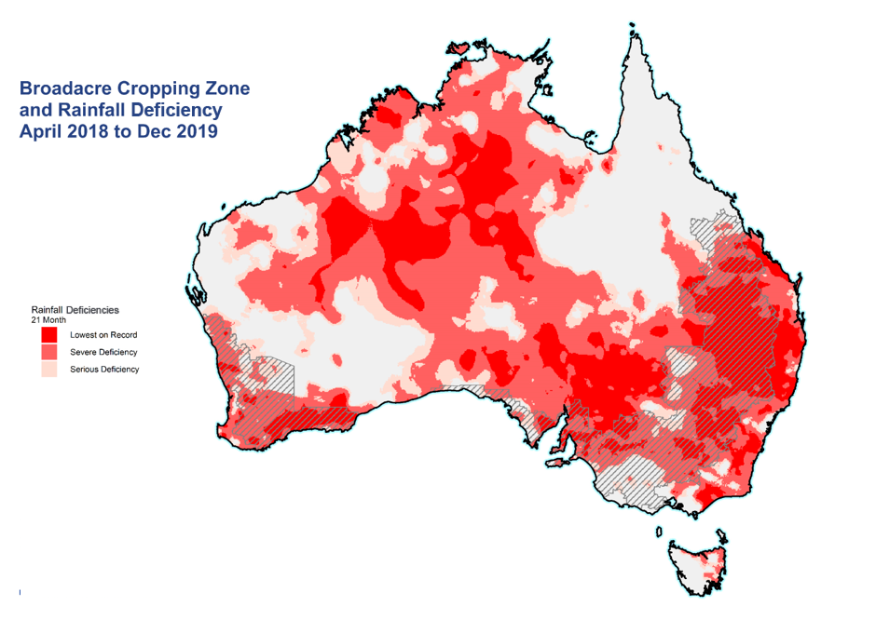

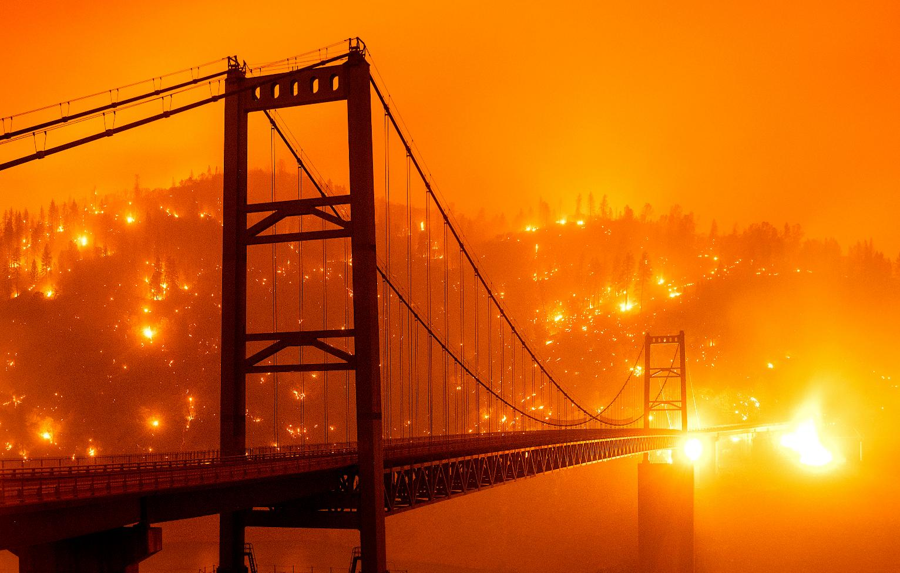


Wildfires Spread and Real-Time Simulations
SIMONE
Computational Physics state-of-the-art
Weather Research & Forecasting (WRF)
It takes hours for a single run
Notes:
Recently, wildfires have been increasingly growing in frequency and intensity, becoming a serious threat for living beings and socio-economic stability all over the world. Both Australia and California suffered from the most severe wildfire seasons recorded in modern history
So with this premise … What is our goal here?
In such worrisome scenarios, we’d like to have fast and accurate wildfire spread simulators that can run iteratively in order to evaluate several containment strategies.
The current state of the art, from computational physics is WRF is able to produce accurate predictions but… stop! … each simulation takes several hours, which is acceptable for a single run … but not for our needs.
In order to reach our goal, it is essential to increase the computational efficiency, which luckily, can be done, in the evaluation phase, thanks to SciML techniques.

Slide 3


Why Julia?
SIMONE
Julia is a high-performance, high-level dynamic programming language
Feels like Python, works like Lisp, fast like C (Nick Eubank)
Core feature: type-stability trough specialization via multiple-dispatch
Easy for a compiler to make into efficient code
“It looks like a scripting language”
SciML community
Notes:
Julia is a dynamic programming language which has the great advantage of being both high-performance and high-level. The possibility to write high-level code on a fast compiled language is secured by two key features:
type inference (implemented through an algorithm which deduces the types involved in function calls before JIT compilation)
type specialization (though functions don’t explicitly require the input types In advance, under the hood they actually take different pre-structured forms depending on the input types, therefore enhancing the performance).
This two features give rise to multiple dispatch, Julia’s core feature.
On top of this, the SciML community has developed and is still developing a highly performant ecosystem for scientific simulations and machine learning. Libraries like DifferentialEquation.jl and NeuralPDE.jl enabled us to put our ideas into practice.

Slide 4
Why Physics Informed Models?
SIMONE
Regular Machine Learning
K. Hornik, Neural Networks, 4(2), 251-257, (1991)
Neural Networks can approximate any non-linear function with desired accuracy (Universal Approximation Theorem)
Big data are needed for ML models in order to perform well
Regular Scientific Modeling
Differential equations encode scientific knowledge deduced from physical laws
Notes:
NN’s approximation properties (this is not so rigorous mathematically: the theorems I’m implicitly referring to require some conditions on the function to be approximated); but also Fourier series or polynomials have similar properties for some classes of functions. It is also the case that tensor products of universal approximators give higher dimensional universal approximators. The difference those and NNs lies in the curve of dimensionality. As the dimensionality of the problem increases, the computational costs of a numerical equation solver grows exponentially, while PINNs can be proven to have a polynomial bound.
Unfortunately, purely ML models need a lot of data… Here’s where prior scientific knowledge comes into play: including physical laws in the form of PDE in NNs enables us to reduce the space of all possible solutions to the physically admissible ones. Hence, less data is needed and the model can get faster too. In fact the major advances in machine learning were due to encoding more structure into some model, where “more structure” basically means faster and better fits from less data. SO, on one hand purely ML models are too “dumb”, on the other hand solving PDE without ML can get very difficult and can take longer.

Slide 5
Why Physics Informed Models?
SIMONE
Including physical laws into ML models gives rise to Physics Informed Neural Networks:
Data-driven solutions of PDEs
Data-driven discovery of PDEs
They overcome the curse of dimensionality
P. Grohs et al., arXiv:1908.10828 [math.NA], (2019)

Slide 6
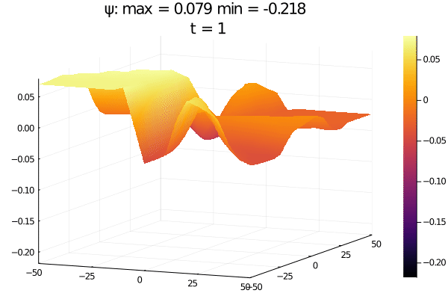
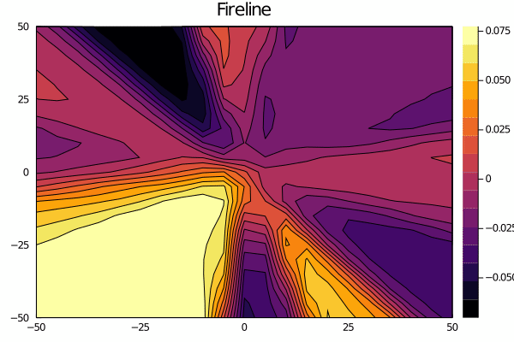
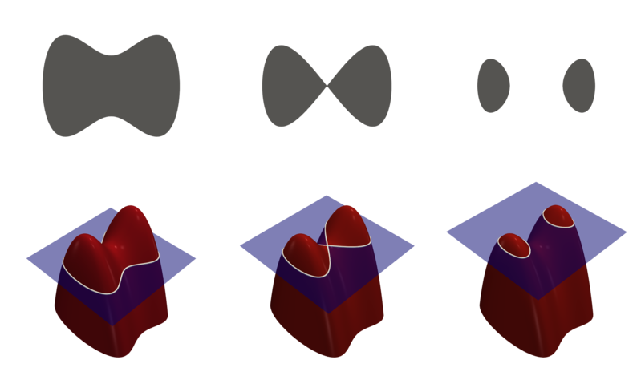
The Level Set method and the level set equation
VALERIO 3:30
Text
J.Mandel et al., Geoscientific Model Development
Picture credits: (CC-BY) https://commons.wikimedia.org/wiki/File:Level_set_method.png
Notes:
I’m not going for a complete tour of the WRF model for wildfires since it would involve a lot of math, ugly PDEs systems and stuff ….
But I’m just going to spend a few words on one PDE, the Level Set Equation which is the mathematical core of the SFIRE module
In WRF, the propagation of a fire burning is implemented by the level-set method, which evolves a function \psi called «level set function»
Such that the burning are at time t is \Omega
And the fireline, which is the boundary of the burning region \Gamma(t)
The model adopts a semi-empirical approach, where the fire spread rate S is computed from fuel (basically the ground is made up of different chemical compounds, fuels) properties, using the Rothermel formula
Where R_0 represents the spread rate in the absence of wind, \phi_W is the wind factor and \phi_S the slope factor (which depends on the ground morphology)
(Last ingredient: on the fireline the tangential component of the gradient \grad \Phi = 0, meaning that the fire propagation speed is normal to the fireline \Gamma)
Now we are ready to write down the Level-Set Equation … in WRF this is solved numerically by a second-order Runge-Kutta method

Slide 7
Level Set Equation for fire simulation
VALERIO
Level Set Function:
Burning Area:
Fireline:
Rothermel Formula:
Spread rate in the absence of wind
Wind factor
Slope factor
Level-Set Equation:
J.Mandel et al., Geoscientific Model Development
Notes:
I’m not going for a complete tour of the WRF model for wildfires since it would involve a lot of math, ugly PDEs systems and stuff ….
But I’m just going to spend a few words on one PDE, the Level Set Equation which is the mathematical core of fire spread
In WRF, the propagation of a fire burning is implemented by the level-set method, which evolves a function \psi called «level set function»
Such that the burning are at time t is \Omega
And the fireline, which is the boundary of the burning region \Gamma(t)
The model adopts a semi-empirical approach, where the fire spread rate S is computed from fuel (basically the ground is made up of different chemical compounds, fuels) properties, using the Rothermel formula
Where R_0 represents the spread rate in the absence of wind, \phi_W is the wind factor and \phi_S the slope factor (which depends on the ground morphology): the algorithm contains all the necessary expressions for the calculation of the fire spread rate, taking into account the values of the wind, the altimetric profile, the fuel map etc etc ..
(Last ingredient: on the fireline the tangential component of the gradient \grad \Phi = 0, meaning that the fire propagation speed is normal to the fireline \Gamma)
Now we are ready to write down the Level-Set Equation .. Here you are … in WRF this is solved numerically by a second-order Runge-Kutta method

Slide 8
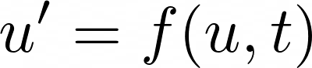
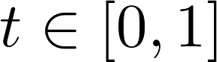
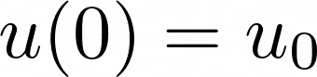
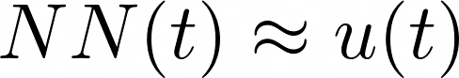
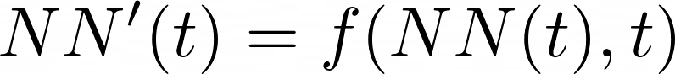
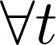
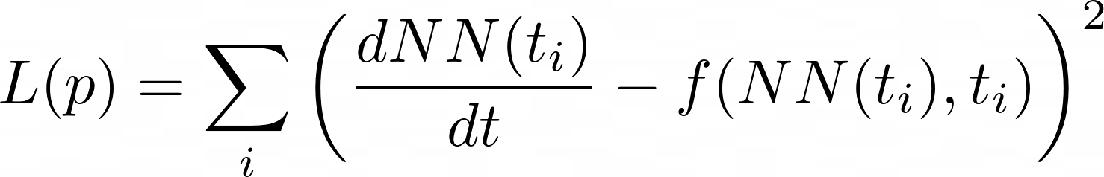
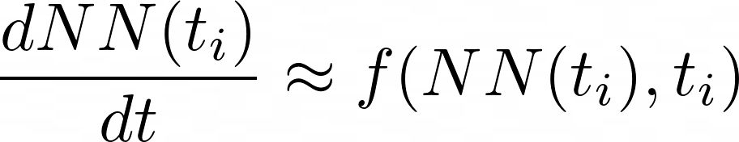
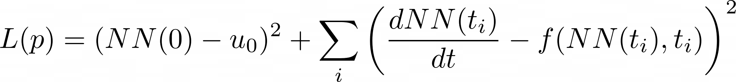
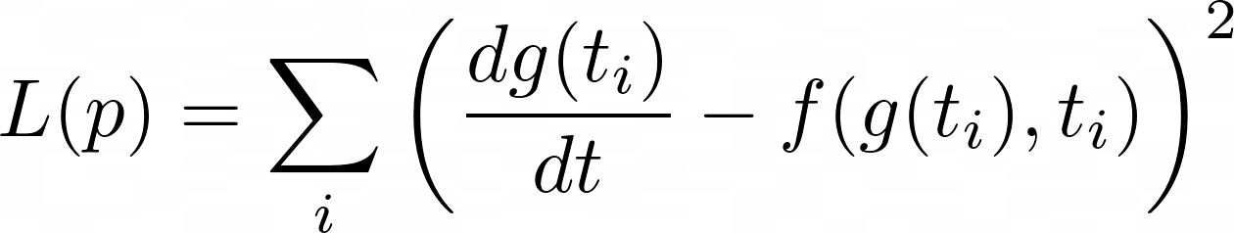
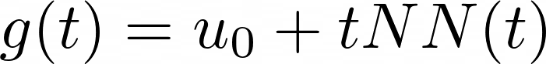
Solving ODEs with Neural Networks
VALERIO
System of ODEs
NN approximation
Loss Function
minimization
Handling initial condition
More efficiently
Notes:
This is a result first due to Lagaris et. al from 1997. The idea is to solve differential equations using neural networks. How? by approximating the solution by a neural network and training the resulting network to satisfy the conditions required by the differential equation.
Let’s say we want to solve a system of ordinary differential equations
u’= f(u,t) with t in [0,1] and a known initial condition u(0) = u_0. To solve this, we approximate the solution by a neural network:
NN(t) ~ u(t)
If NN(t) was the true solution, then it would hold that NN’(t) = f(NN(t),t) for all t. Thus, we turn this condition into our loss function. This motivates the loss function:
L(p) = sum….
The choice of t_i could be done in many ways: it can be random, it can be a grid, etc. Anyways, when this loss function is minimized (gradients computed with standard reverse-mode automatic differentiation), then we have that dNN(ti)dt≈f(NN(ti),ti) and thus NN(t) approximately solves the differential equation.
Note that we still have to handle the initial condition !! One simple way to do this is to add an initial condition term to the cost function. This would look like
L(p) …
While that would work, it can be more efficient to encode the initial condition into the function itself so that it's trivially satisfied for any possible set of parameters. For example, instead of directly using a neural network, we can use:
g(t) = u_0 + tNN(t)
As our solution. Notice that g(t) is thus a universal approximator for all continuous functions such that g(0)=0!!!!! (This is the prior information)
Since g(t) will always satisfy the initial condition, we can train g(t) to satisfy the derivative function, then it will automatically be a solution to the derivative function. In this sense, we can use the loss function
L(p) = sum_i
where p are the parameters that define gg, which in turn are the parameters which define the neural network NN that define g. Thus this reduces down, once again, to simply finding weights which minimize a loss function!

Slide 9
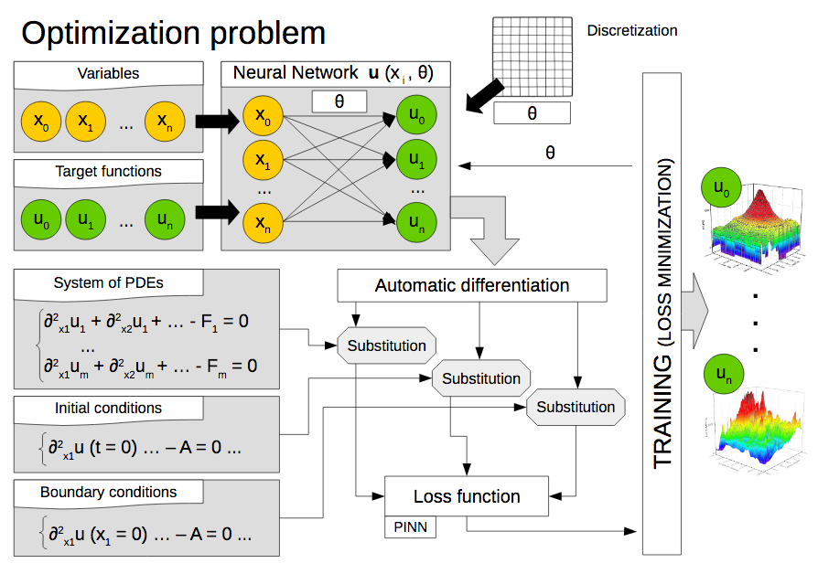
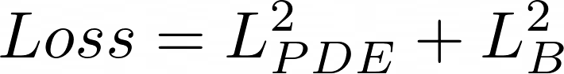

The PINN architecture in detail
VALERIO
Loss Function
^
m
m
NeuralPDE.jl
ModelingToolkit.jl
m
C. Rackauckas et al., Journal of Open Research Software (2017)
C. Rackauckas et al., arXiv:2001.04385 [cs.LG], (2020)
Notes:
We have replaced the numerical solvers with a profoundly different approach, by employing the recently developed Julia packages NeuralPDE.jl and DiffEqFlux.jl which support Physics Informed Neural Networks.
The underlying architecture can be summarized by the following steps. Let’s put ourselves in the most general case, where we want to find m+1 target functions [u_0, …, u_m] which satisfy a system of n PDEs. We first construct a surrogate solution to u(x) as a neural network u_hat(x;\theta) with n inputs and m outputs and parameters \theta; since a neural network is mathematically a composite function, the derivaties of u with respect to its input can be evaluated by applying the chain rule for differentiating compositions of functions using automatic differentiation (AD).
Then we need to define a loss function in order to calculate the discrepancy between u_s and the outputs of the neural network, this is where we force our network to satisfy the physics imposed by the PDEs.
The loss function is made up of two parts: the former minimizing the L^2 norm referred to the PDE definition and the latter minimizing the L^2 between the boundary condition and the solution evaluated at the boundary
The last step is to train the neural network….
It is straightforward that minimizing the loss function means solving the equations, since we are approximating our target functions with u_hat better and better
The key point is that it converts an integration problem into a mere minimization task and it does not need data to train, because it is trained on the PDEs themselves The resulting neural network form a new class of universal function approximators that naturally encodes any underlying physical laws as prior information.
(Minimization problem is handled easier than an integration problem)

Slide 10
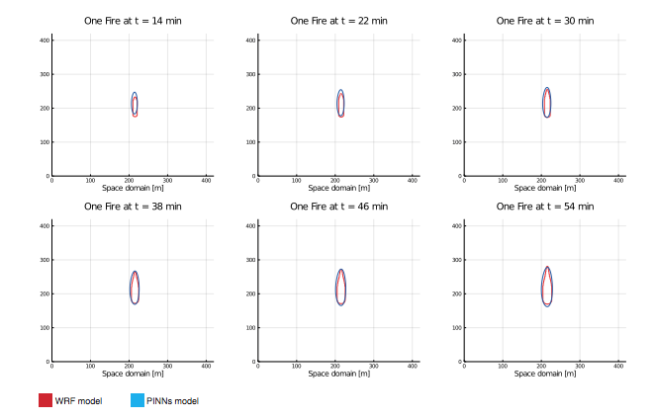
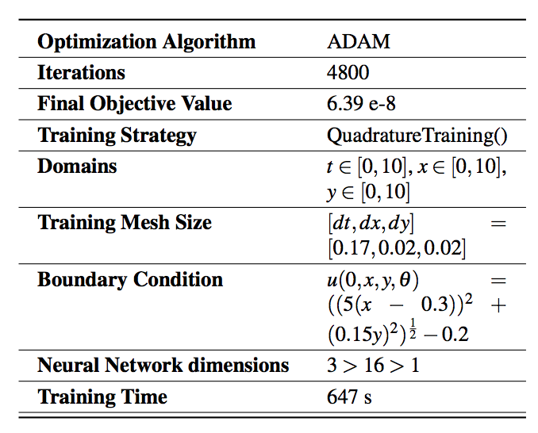
Implementation - «One Fire» Simulation
LUCA
5:30
Notes:
The level set equation, i.e. is a 2D surface embedded in a 3D euclidean space is initilially set as the distance of each point from the ignition line.
In our approach it is required that every quantity is provided either as a constant or as a function. Therefore we implemented the initial condition as a cone with elliptical section, because we had to deal with circular and linear ignition shapes
ONE FIRE
It is a simple case, where we have only one ignition point, that demonstrates that our model works well in case of fires that spread in flat areas where the fuel doesn’t change. It also evolves according to the wind direction.
Here are some specs
We have been using ADAM as the optimization algorithm
AS you can see the final objective value is , it didn’t take long → around 11 minutes and nearly 5000 iterations
Time and spatial domains are all between 0 and 10
And the mesh size for training is finer for space
Initial condition is a cone with elliptical section
As you can see the neural net is shallow and the number of parameters is somewhat very small compared to the vast majority of cases where NNs are employed
Here you can see the results at different time frames

Slide 11
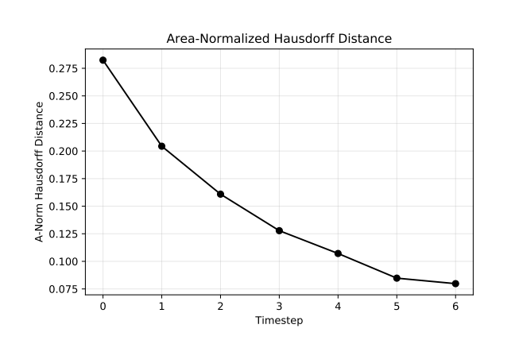
«One Fire» Simulation - Metrics
LUCA
Hausdorff Distance
Notes:
In order to provide a quantitative measure of the error between the outputs, we decided to use the Hausdorff distance (which has been further normalized on the burning area)
The fact that the Hausdorff distance decreases, another confirmation is in the plot below, tells us that as the area grows with time, the difference between the two regions doesn’t increase, meaning that they evolve in synchrony and with the same shape

Slide 12
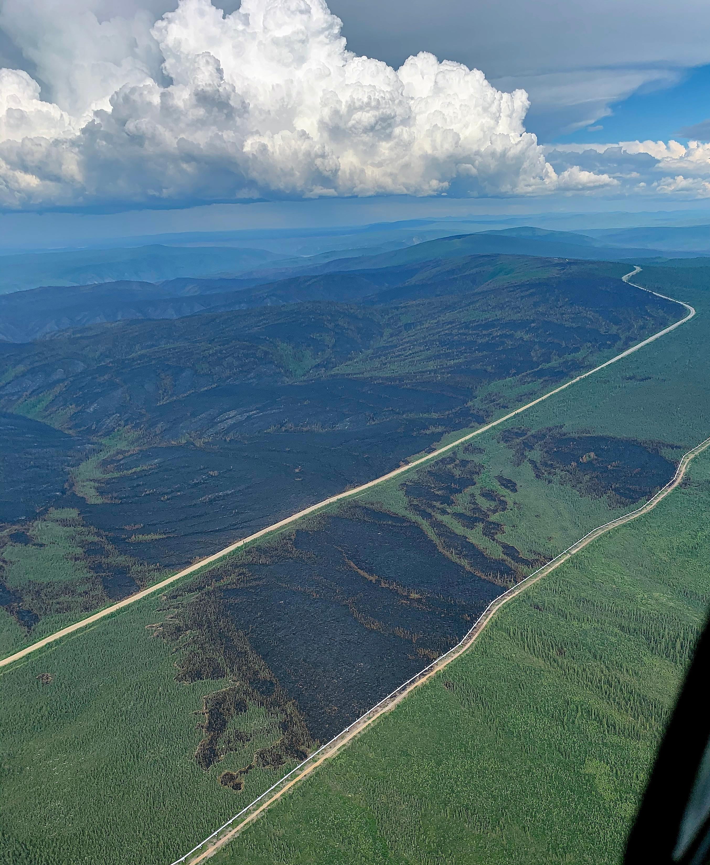
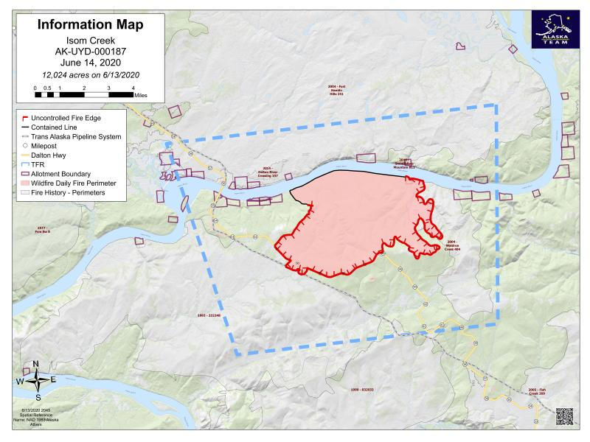
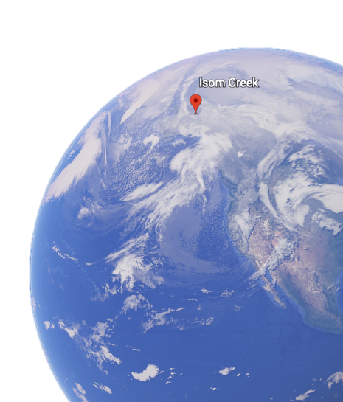
LUCA
Implementation: Isom-Creek fire simulation
June 2020
https://data.statesmanjournal.com/fires/incident/photograph/6758/20/98081/
Notes:
The fact that the Hausdorff distance decreases, another confirmation is in the plot below, tells us that as the area grows with time, the difference between the two regions doesn’t increase, meaning that they evolve in synchrony and with the same shape
Here on the right, the contour time evolution : I don’t blame you if you’ve thought that WRF firelines look like wine-bottles. Well if you haven’t I guess you don’t have an Italian bias.

Slide 13
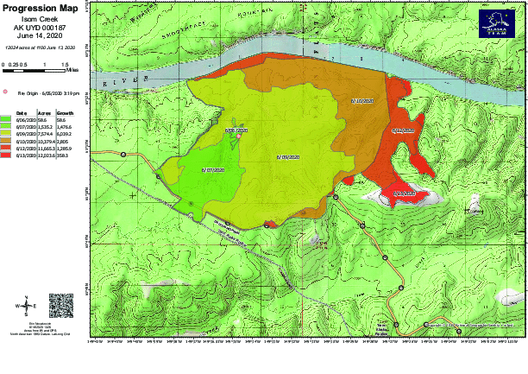
LUCA
Implementation: isom-Creek fire simulation
https://data.statesmanjournal.com/fires/incident/photograph/6758/20/98081/
Notes:
The fact that the Hausdorff distance decreases, another confirmation is in the plot below, tells us that as the area grows with time, the difference between the two regions doesn’t increase, meaning that they evolve in synchrony and with the same shape

Slide 14
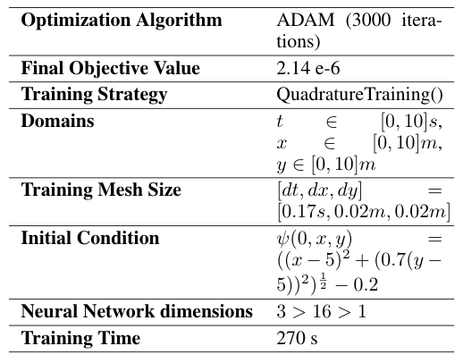
Implementation - Isom Creek Simulation
LUCA
Notes:
The fact that the Hausdorff distance decreases, another confirmation is in the plot below, tells us that as the area grows with time, the difference between the two regions doesn’t increase, meaning that they evolve in synchrony and with the same shape

Slide 15
Isom Creek Simulation - Metrics
LUCA
Hausdorff Distance
Notes:
The fact that the Hausdorff distance decreases, another confirmation is in the plot below, tells us that as the area grows with time, the difference between the two regions doesn’t increase, meaning that they evolve in synchrony and with the same shape

Slide 16
Advantages of the PINN architecture
FRANCESCO
6:00
Relatively small neural networks suffice interpretability
Interpolating the solution on a continuous mesh
Extending the predicted solution outside of the training domain
Backward in time evolution
Speed up of the simulator run time (order of hundreds of seconds vs order of the hour) containment strategies
Learning the hidden physics
Notes:
So, on top of everything my colleagues have explained up to now, we can put together a list of the advantages of the architecture employed.
- In the first place, one of the most important advantages is the speed up of our model with respect to the original one (it took some hundreds of seconds vs one hour approx). This was our main goal and is necessary to run the simulator iteratively in order to simulate the outcome of different containment scenarios and choose the best among them, thus providing more instructions to the firefighters as to how to proceed.
However, this point has to be further studied: on one hand, we used a simpler set of inputs for reasons we will explain later; on the other hand we worked on one of the eight cores at our disposal because the multi-threading and GPU optimisation of the libraries wasn’t ready yet, which would give us more space for an extra speed up. So of course this results could be updated in the future in light of the frequent improvements of the NeuralPDE library.
(Puntualizzare che speed up c’è per alta dimensionalità solo)
Thanks to the physical prior introduced in PINNs, this architecture requires relatively small networks to be accurate, reducing the overall computational cost and increasing performance. In quantitative terms, we employed a single hidden layer with 16 neurons. Adding the extra variables we haven’t been able to include yet could require adding a second layer for example, still much smaller then the network we would have needed without using PINNs. As a consequence, the model is more interpretable (it is less similar to a complete black-box) and its users can run the resulting simulator on standard PCs without needing high performance machines, which is another practical advantage.
Another key advantage is that, since neural networks approximate functions as we have said before, the output can be evaluated on a continuous mesh, whereas numerical methods are limited to the discrete mesh given as input.
In addition, while numerical methods only solve on the initial domain range, this architecture learns the neural network parameters that can be used to extend the predicted solution outside of the training domains (with a decrease in accuracy if the extrapolation is extended too much).
It’s possible to investigate the evolution of the system backwards in time, just by imposing the boundary condition at a time different from zero. This can be used for ”forensic investigations”: it is possible to reconstruct the ignition point and the evolution of the fire-line from the final state of the wildfire.
PINNs provide a tool to refine theoretical models. Adding input data to the physical prior can be used to tune some parameters of the differential equations involved.
((i7 10700K 8 core fisici, 10 virtuali
RAM: 64 GB DDR4
GPU: Nvidia 2080 Ti con 11 GB di GDDR6
Storage: 8.5 TB, sistema su stato solido))

Slide 17
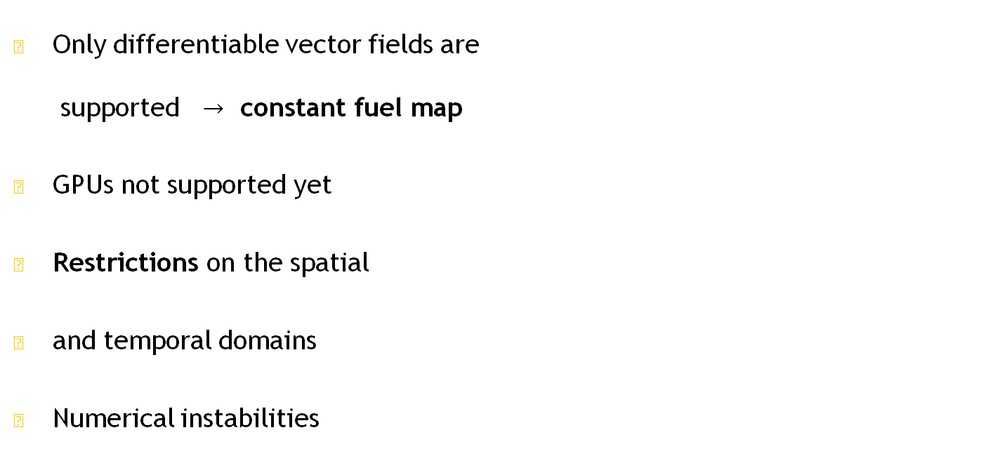
Limitations
FRANCESCO
Only differentiable vector fields are supported $→$ constant fuel map
GPUs not supported yet
Restrictions on the spatial
and temporal domains
Numerical instabilities
Notes:
The library doesn’t support the usage of matrices as functions of their indices. We can only include differentiable vector fields, and this means it is not possible to use a variable fuel map (discontinuous function), fundamental in order to capture the evolution of the fire with higher accuracy (now the perimeter is smooth). We opened an issue about this.
At the moment, it cannot be run on GPUs nor multiple CPUs because the library we used is not fully developed yet. We contacted the developers and they are working on it.
The model only works on relatively small domains and is unstable for larger ones. Our spatial and temporal input domains range from 0 to 10 which are arbitrary units for the model. Therefore we had to scale down all the quantities involved and introduce scale factors on the fire spread rate in order to make it compatible to the evolution of the output of WRF.
Our approach suffers from numerical instability depending on the training strategy adopted and on the number of neurons and layers.

Slide 18
Future work
FRANCESCO
Notes:
Here is a detailed possible schedule for the main improvements to be made. The main work that needs to be done is fixing the limitations I listed and the Julia Sci-ML community is working hard on this and is frequently releasing packages updates with various improvements, so it’s only a matter of time.
Finally, to make this reasearch a ready to use product for firefighters, we need a wrapper inside the WRF Fortran code to embed the implementation of the architecture in Julia and merge it with the rest of the simulator.
Another improvement would be being able to solve the 7-equation Euler system of PDEs with PINNs method. We have began experimenting with it but the aforementioned limitations haven’t made it possible yet.

Slide 19
Conclusion
FRANCESCO
Our work has the aim of evaluating the applicability of the PINNs architecture, as implemented in NeuralPDE.jl, to real problems of Climate Physics, focusing on wildfire simulation.
This could be a first step towards the spreading of this technology beyond the research environment, up to production-grade software.
The current limitations are relevant, especially because of the early development stage of some libraries, but this work definitely shows that it is worth to further investigate PINNs-based simulators.
Notes:
The study we carried out had the goal to investigate the applicability of Scientific Machine Learning on climate, wildfires in particular, models. The results show that many improvements are needed in order to transform this into a validated product; we need to add some refinements to the implementation in order to carry out a precise time comparison between the two approaches. The encouraging outcome inspires us to continue our work by improving the architectures and possibly employ them in different fields of research. We hope our work will be the starting point for a more effective cohesiveness between Machine Learning and Physical Models in Climate Science, and thus further explored by other researchers.
(Validation of the libraries, stress test.)

Slide 20
Acknowledgements
We acknowledge University of Turin, Machine Learning Journal Club for supporting.
We thank Professor Enrico Ferrero (Università del Piemonte Orientale), Professor Massimiliano Manfrin (University of Turin) and the whole Atmospheric Physics and Metereology Group, PhD Christopher Rackauckas (Massachussets Institute of Technology), PhD Kirill Zubov (Saint-Petesburg State University), Vaibhav Dixit (Julia Computing), PhD Brian Wee (Founder at Massive Connections), Dr. Rustem Arif Albayrak (NASA), PhD David Marvin (CEO at Salo Sciences), Professor Piero Fariselli (University of Turin) and Pietro Monticone M.Sc. student (University of Turin), for their precious help and availability.
We acknowledge the company Mollificio Astigiano (Belveglio, Asti, Italy) for providing the computational power needed for this research and the HPC4AI center of the University of Turin for their support.

Slide 21

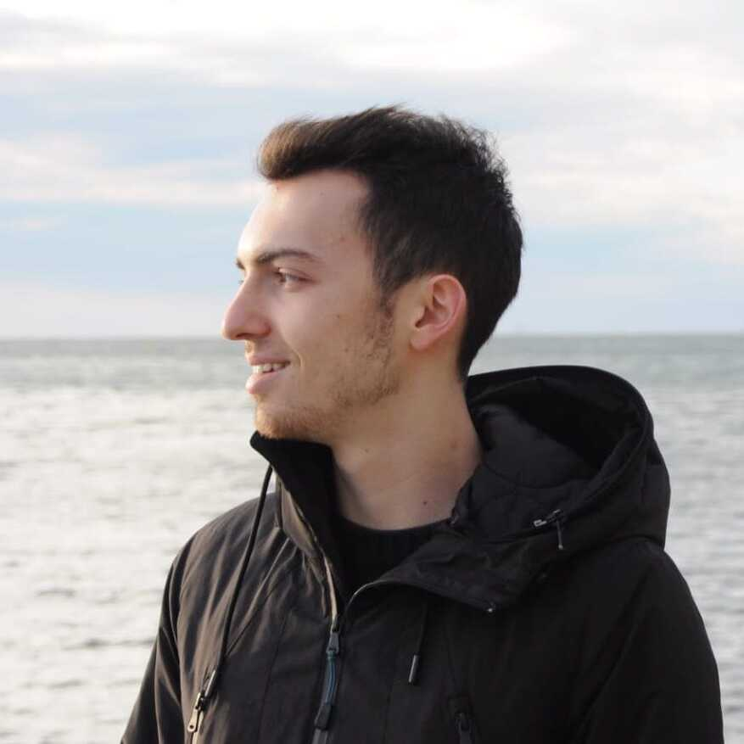
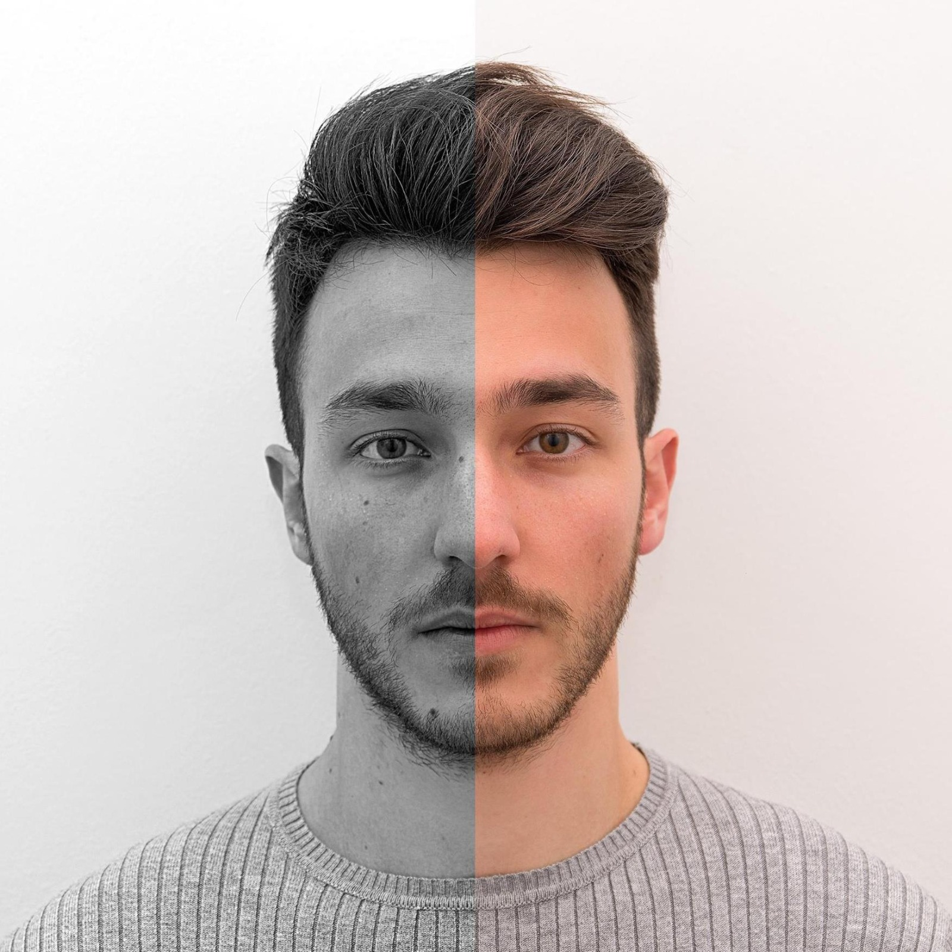

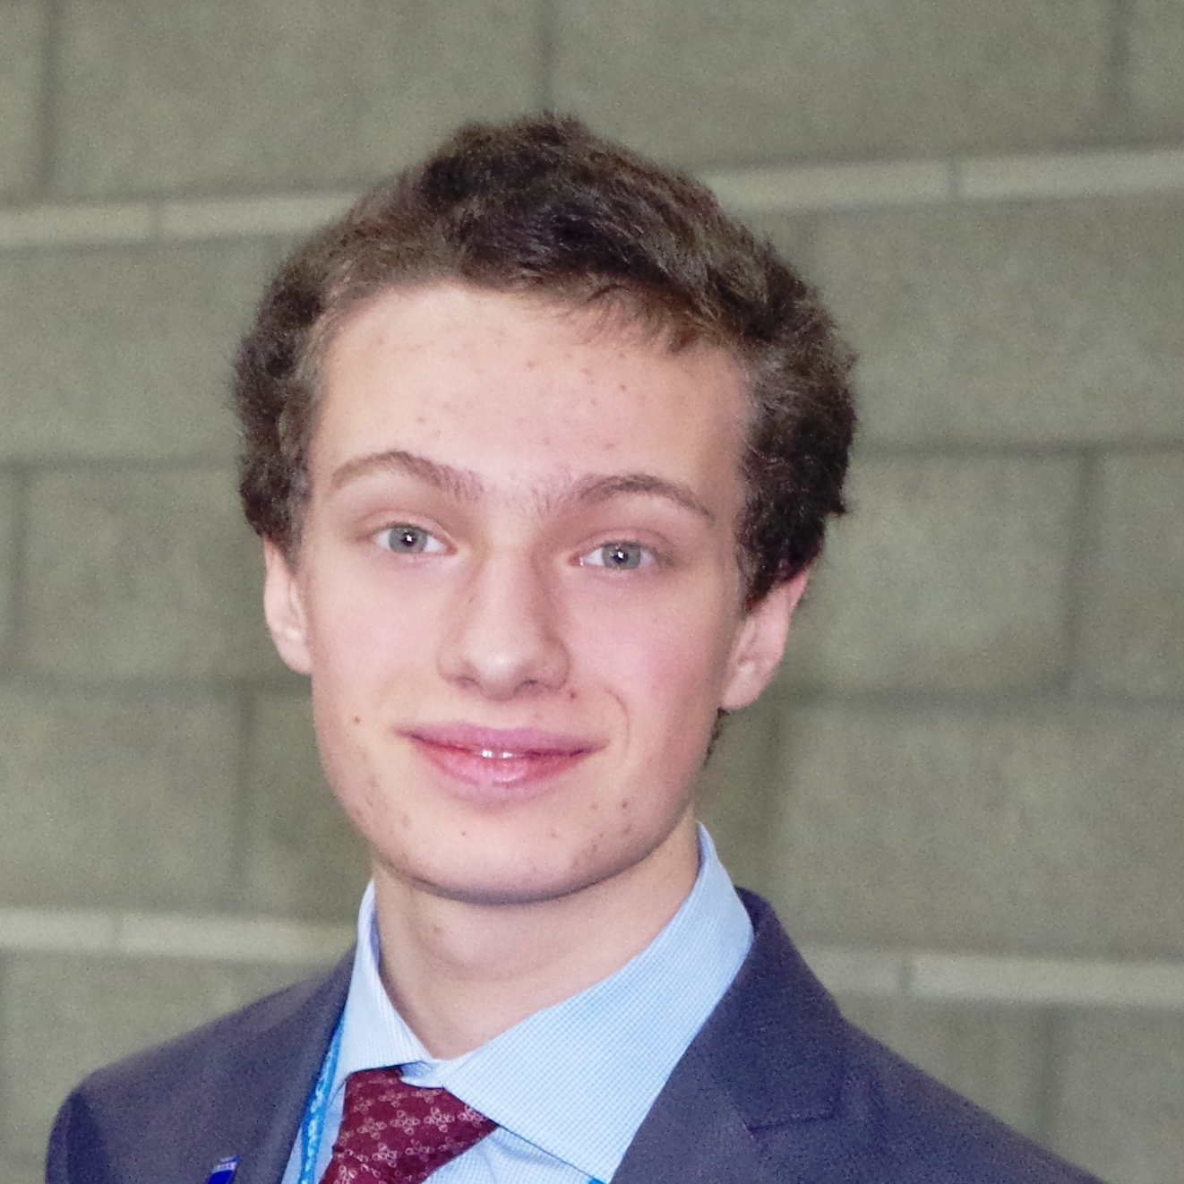
Presenting authors:
Dipartimento di Fisica - Torino
Machine Learning
Journal Club
Francesco Calisto¹
Simone Azeglio²
Undergraduate Physics student, University of Turin
Master student Phys, Complex Systems, University of Turin
Luca Bottero¹
Valerio Pagliarino¹

